Slide 1

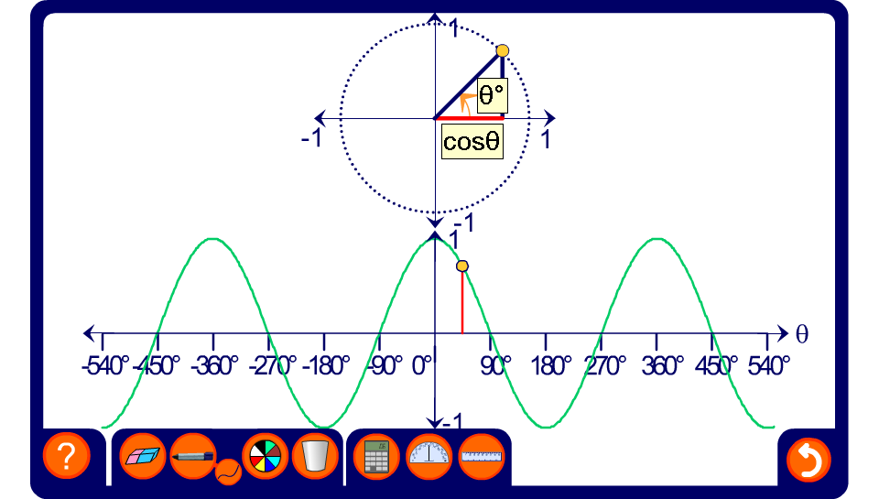


The graph of cos θ
Notes:
Trace out the shape of the cosine curve and note it properties.
The curve repeats itself every 360°. Also, –1 < sin θ < 1.
The cosine curve is symmetrical about the vertical axis.

